Slide 1


Bridging Gaps – a HubSpot Success Story
CASE STUDY
The Challenge
A new brand, a leaner team and big marketing goals
Precision AQ revolutionizes healthcare by integrating cutting-edge technology with deep market insights to widen patient access and care.
With a bright new brand and leaner marketing and sales team, Precision needed to expand their use of HubSpot to achieve their marketing goals while maintaining day-to-day digital operations.
New Era provided expert HubSpot guidance to help Precision advance their marketing campaigns across paid, email, web and event channels and firmly establish its new brand.
1

Slide 2
Activities
End-to-End Campaign Delivery
Created the workflow to capture
LinkedIn Leads and push to Salesforce campaign lists
Developed, tested and scheduled email nurture campaign for events
Set up landing pages and campaigns
for in-person events
Updated to a persona-based email subscription model
Migrated website from WordPress to HubSpot
Improved web design and expanded
blog and conference/event presence
and effectiveness
Strategy & Analytics
Provided strategic guidance, competitive analysis and planning
Delivered custom training guides, videos and documentation
Created a monthly New Deals and Contacts reports for the inside sales group
CASE STUDY
Approach
Back to the basics: Event, email, web, competitor analysis, reporting
Our initial focus was to create HubSpot workflows to push events
and webinar leads into Salesforce CRM. We then launched new email nurture campaigns for these events.
We also migrated their website from WordPress to HubSpot to reflect the new brand with enhanced navigation, landing pages and web components fully supporting its international division as well. PAQ quickly found that leaving WordPress for HubSpot, meant it was easier for non-technical team members to make copy edits and manage routine updates like blogs and expert listings.
While this new digital framework was in flight, we conducted an analysis of competitor SEO/SEM, conference and social media activities and created new marketing-to-sales reports.
With an informed strategy and key HubSpot systems in place, Precision can now more efficiently and effectively drive traffic, capture leads, and achieve marketing goals.

Slide 3
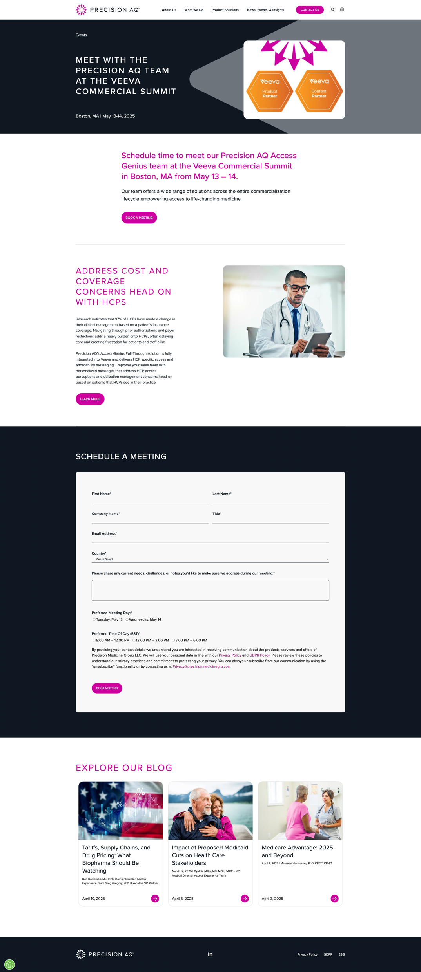
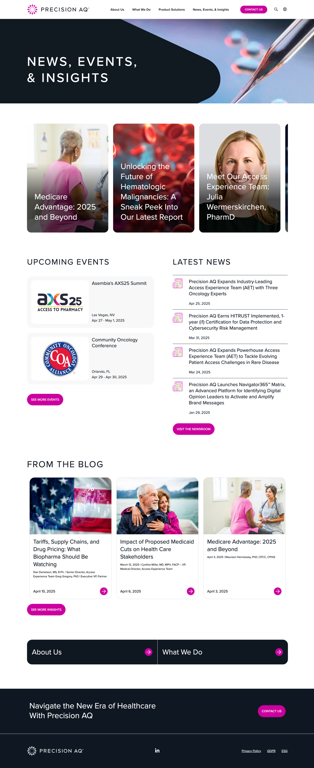
Event Template & Meeting
Request Form
News, Events & Insights Page
CASE STUDY
End-to-End Campaign Delivery
Formalized use of brand colors and fonts
Easy toggle from US and International pages
From strategy to development and insights
LinkedIn advertising and
email nurture campaigns
Data flow from HubSpot
to Salesforce
Enhanced web design
and content
Monthly sales reports
Videos, documentation,
training and hands-on support
Easy navigation among content categories
Simple lead capture form
Features new brand, sharper imagery
Added blogs to keep users on site

Slide 4
CASE STUDY
Outcomes
Optimized HubSpot campaign delivery with templates, workflow set-up and automations.
1
Today, Precision has a framework to efficiently deliver full-scale marketing campaigns—from advertising, email, web and event promotion, to sales analytics.
With a shared vision, Precision AQ now leverages more functionality from HubSpot, which takes the heavy-lifting, and they are poised for greater long-term marketing success.
“New Era quickly integrated with our team to enhance our HubSpot capabilities. Their next-level thinking, attention to detail, thoughtful execution and hands-on training have been essential to our marketing success.”
– Christy Dempster, VP, Marketing, Precision AQ
Empowered marketing and sales teams with strategic guidance and day-to-day marketing support and training.
2

